Slide 1
COMBINATIONAL CIRCUITS
COMPUTER SYSTEM ARCHITECTURE
BY:
ROSHNI PATOA

Slide 2
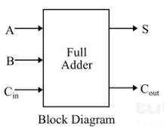
FULL ADDER
Full adders are fundamental building blocks in digital circuits
Used to add three binary digits: A, B, and C
Produces two outputs: Sum and Carry-out
Essential component for arithmetic operations in computers

Slide 3
Inputs and Outputs
Inputs: A, B, C
Outputs:
Sum, Cout
Total possible input combinations: 2³ = 8

Slide 4
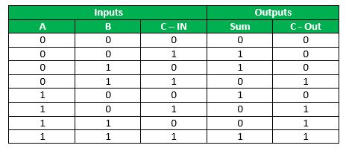
Truth Table for FULL Adder

Slide 5
Logic Gates in FULL Adder
XOR gates: Used for generating Sum
AND gates: Used in carry generation
OR gate: Combines carry terms

Slide 6
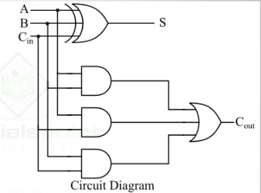
FULL Adder Circuit Diagram
Inputs: A and B
XOR gate connected to both inputs, output is Sum
AND gate connected to both inputs, output is Carry

Slide 7
BOOLEAN EXPRESSIONS FOR FULL ADDER
Input A, B, C
Sum = A ⊕ B ⊕ Cin (⊕ represents XOR operation)
Cout = AB + (A ⊕ B)Cin / AC + AB + BC

Slide 8
Example 1
Inputs: A = 1, B = 0, Cin = 0
Step through the circuit
Calculate Sum: 1 ⊕ 0 ⊕ 0 = 1
Calculate Cout: (1 × 0) + (1 ⊕ 0) × 0 = 0
Result: Sum = 1, Cout = 0

Slide 9
Example 2
Inputs: A = 1, B = 1, Cin = 1
Step through the circuit
Calculate Sum: 1 ⊕ 1 ⊕ 1 = 1
Calculate Cout: (1 × 1) + (1 ⊕ 1) × 1 = 1
Result: Sum = 1, Cout = 1

